Slide 1
Face search
Oct 2014
Nam wook kim

Slide 2
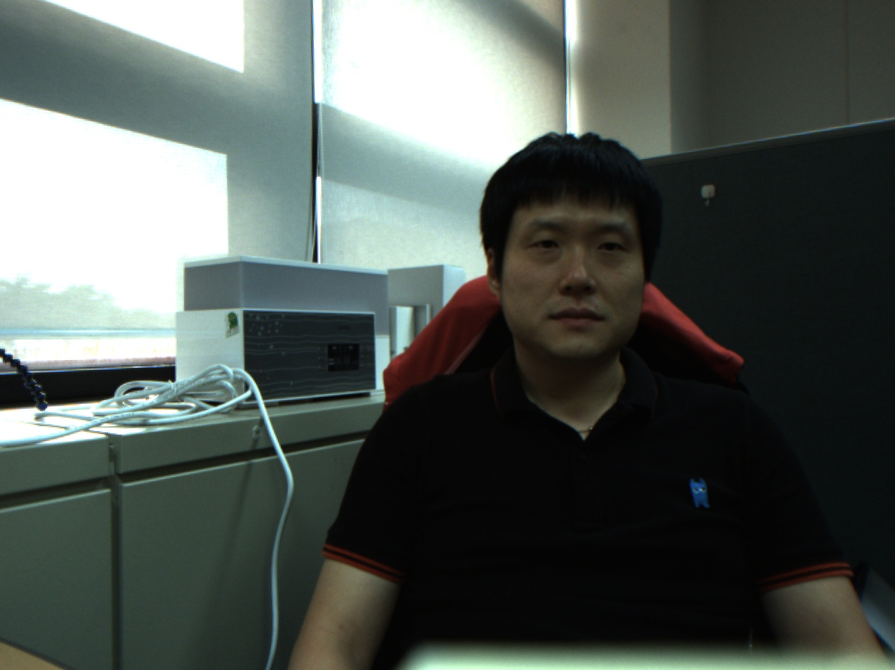

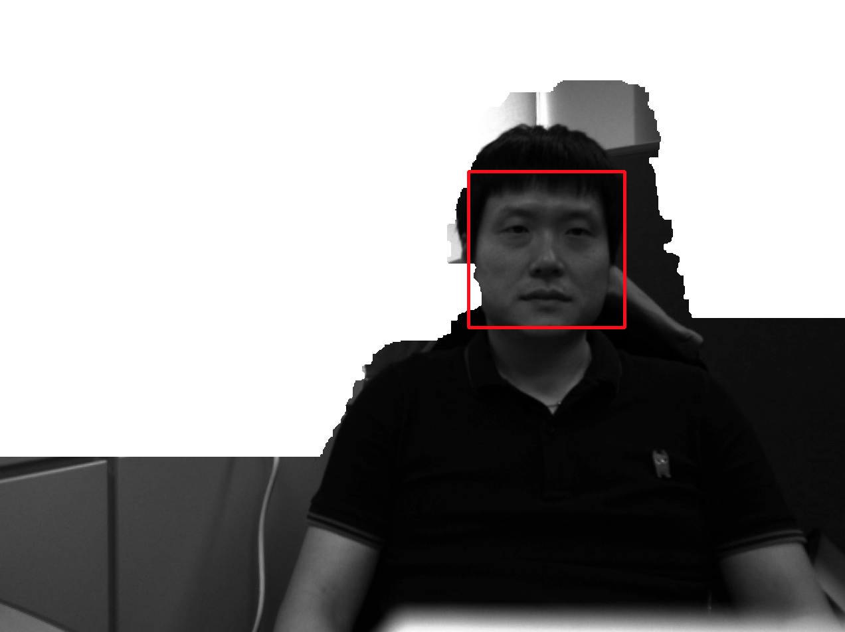
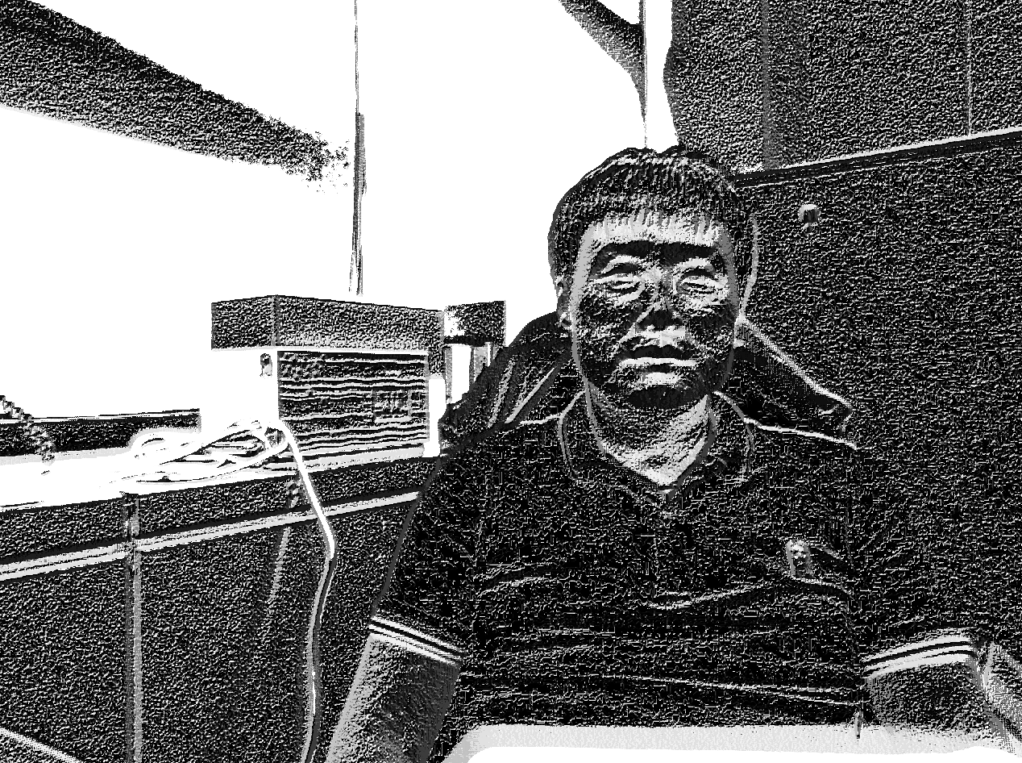
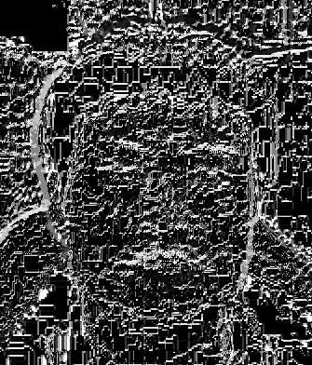
System Overview
Content-based Face Image Retrieval based on Local Binary Patterns
Query image
Extract
Foreground Image
Detect
Face Regions
Calculate
LBP Histograms
Similar Images
Calculate
Similarity Score
Generate
Feature Vectors
Feature Vectors
Image Database

Slide 3
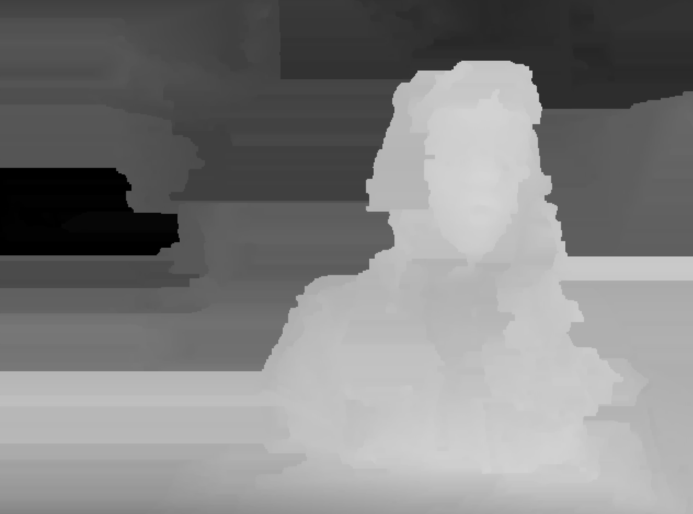
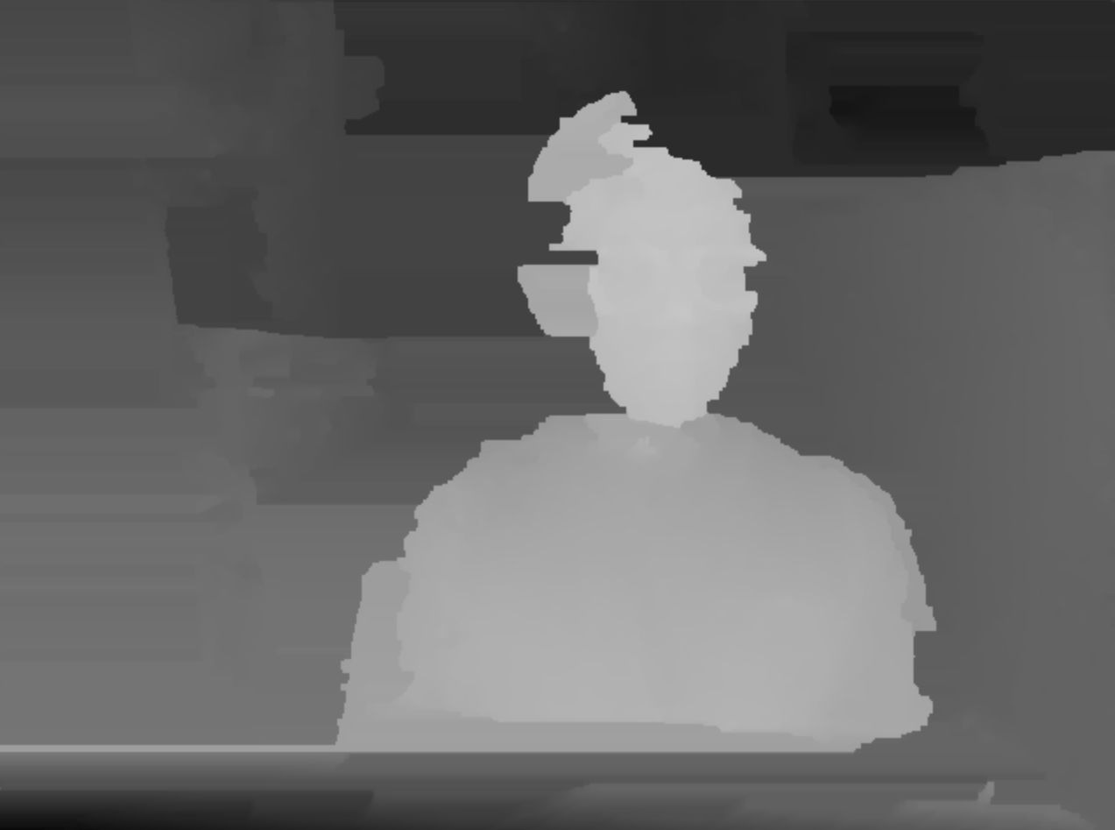

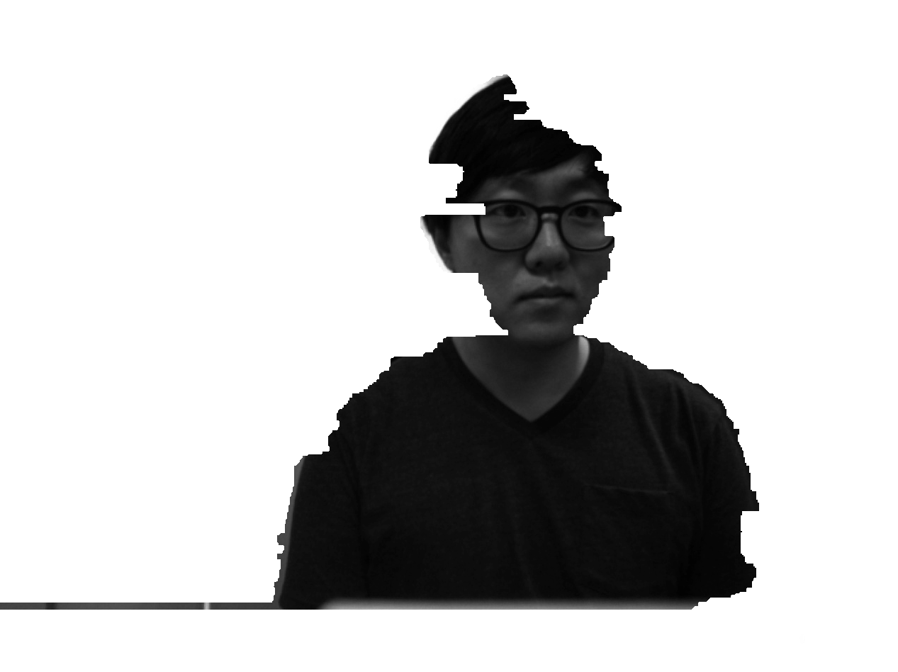
Foreground segmentation
K-mean clustering to segment foreground images
This step is optional because
Face detection rate dropped significantly (the quality of depth image is not good: see below)
Need to deal with an image set without depth information, such as public image set
Cluster1 centroid : 71.7
Cluster2 centroid : 186.0
* Centroid value means intensity levels in [0, 255].
Cluster1 centroid : 81.5
Cluster2 centroid : 171.0
If the depth quality is bad,
the face is not detected!

Slide 4
Face Detection
Pre-trained classifier from OpenCV
Lienhart’s tree-based frontal-face detector haarcascade_frontalface_alt2.xml
The detector was selected as it offered the best performance to our image datasets.
Evaluation
- Dataset: 180 images (130 images of a person + 150 images of two persons)
Parameter | Value
scaleFactor | 1.3
minNeighbor | 4
flags | CANNY_PRUNING
minsize | cvSize(20, 20)
maxSize | cvSize(0,0)
Frontface | Detected | Correct | Wrong | Not Detected | Accuracy
alt.xml | 184 | 178 | 6 | 2 | 0.9570
alt2.xml | 182 | 178 | 4 | 2 | 0.9674
alt_tree.xml | 143 | 143 | 0 | 37 | 0.7944
Default.xml | 200 | 177 | 23 | 3 | 0.8719
* In-depth performance evaluation of different classifiers is available: http://nichol.as/papers/Castrillon/Face%20and%20Facial%20Feature%20Detection%20Evaluation.pdf

Slide 5
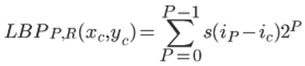
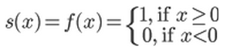
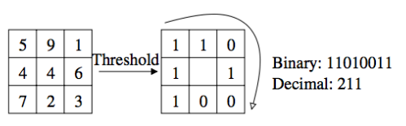
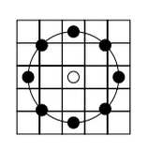
Face recognition-1
1) LBP Definition
Local Binary Pattern is a texture descriptor which codifies local primitives such as edges, spots, and flat areas into a feature histogram. The LBP operator produces 2^P different binary patters.
.
The original LBP operator with 3x3 neighborhood by comparing the center pixel with 8 neighbors.
LBP operator with P=8, R=2. A bilinear interpolation is used to sample neighbor pixels.

Slide 6
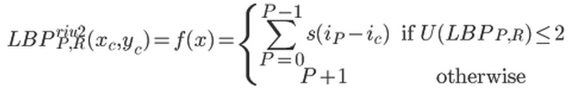
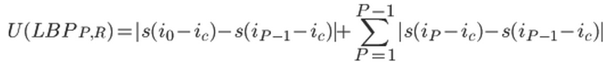
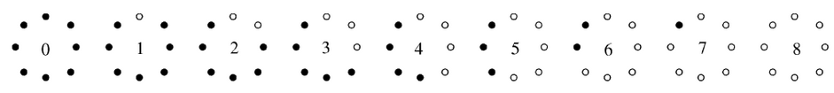
Face recognition-2
2) Rotation Invariant Uniform LBP Definition
Uniform patterns often account for vast majority of all patterns (e.g. 90% in a (8,1) neighborhood or 85.2% in a (8, 2) neighborhood)
We only consider the uniformity measure of at most 2 (i.e. at most 2 bitwise(0/1) change, for example 01110000)
P+1 uniform binary patterns and all other patterns are binned to a single pattern.
Rotation invariant uniform patterns with 8 neighbors and at most 2 bitwise transitions

Slide 7
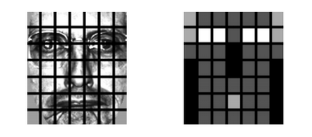
FACE Recognition-3
3) Spatially Enhanced Histograms
Some of facial regions contain more useful information that others (e.g. eyes or nose)
LBP histograms are calculated separately for each region and concatenated.
a facial image divided into 7x7 sub-regions
black squares indicate weight 0.0, dark grey 1.0, light grey 2.0 and white 4.0.

Slide 8
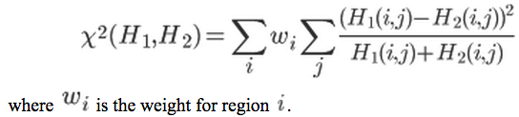
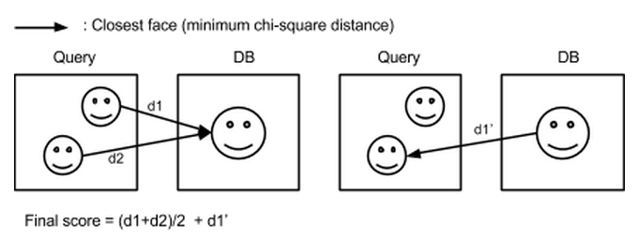
Similarity measure
1) Similarity Between LBP Histograms
In order to measure similarity between LBP histograms of two faces, we use weighted chi-square statistic:
2) Similarity Between Images
-

Slide 9
Evaluation our data-desc
Dataset Description
180 images
130 images of a person and 50 images of two people
18 image classes where each class has 10 images (18x10=180)
Image resolution: 1280 × 960
Variations of Images
Image lighting variation: yes
Expression variation: yes
Change in Head turn, tilt and slant: yes
Change in position of faces: yes
Head scale variation: yes
Background variation: yes
Testing Environment
1.3GHz i5, 8GB 1600MHz DDR3, Intel HD Graphics 5000 1GB

Slide 10
Evaluation our data-result
Experiment Design
(Uniform, Non-Uniform) X (LBP alone, LBP+Hue-LBP) X (1,8, 2,8)
Hard Accuracy= # of images found / 10
- See if how many images in a class are found within 10 images
Soft Accuracy= # of images found x 2 /20
- See if how many images in a class (max=10) are found within 20 images
(R=2,P=16) is not tested as it generates too many patterns (65536 patterns) => Each face generates 65536 x 7 x 7 = 3211264 patterns
R,P | LBP |  |  | LBP+Hue-LBP
 | Avg.Hard Acc | Avg.Soft Acc | Avg.Exe Time | Avg.Hard Acc | Avg.Soft Acc | Avg.Exe Time
nu1,8 | 61.66 | 74.44 | 2.51 | 62.22 | 76.00 | 2.54
nu2,8 | 68.33 | 79.44 | 2.56 | 68.33 | 78.89 | 2.77
u1,8 | 48.89 | 63.33 | 1.54 | 53.89 | 64.44 | 1.61
u2,8 | 58.89 | 66.11 | 1.58 | 60.00 | 67.22 | 1.60
Avg.Feature Extraction : approx. 1.52 sec

Slide 11
Evaluation public data-desc
Source:
http://cswww.essex.ac.uk/mv/allfaces/faces94.html
Dataset Description
Number of individuals: 153 (20 images for each person)
Image resolution: 180 by 200 pixels (portrait format)
directories: female (20), male (113), malestaff(20)
Contains images of male and female subjects in separate directories
Variations of Images
Backgrounds: the background is plain green
Head Scale: none
Head turn,tilt and slant: very minor variation in these attributes
Position of face in image: minor changes
Image lighting variation: none
Expression variation: considerable expression changes
Additional comment: there is no individual hairstlyle variation as the images were taken in a single session.
Testing Environment
1.3GHz i5, 8GB 1600MHz DDR3, Intel HD Graphics 5000 1GB

Slide 12
Evaluation Public data-result
Experiment Design
(Uniform, Non-Uniform) X (LBP+Hue-LBP) X (2,8)
Hard Accuracy= # of images found / 10
- See if how many images in a class are found within 10 images
Soft Accuracy= # of images found x 2 /20
- See if how many images in a class (max=10) are found within 20 images
Non-uniform LBP face generates 256 x 7 x 7 = 12544 patterns (very slow)
Uniform LBP face generates 10 x 7 x 7 = 490 patterns
R,P | LBP+Hue-LBP
 | Hard Acc | Soft Acc | Exec. Time
nu2,8 | 94.64 | 95.23 | 14.07
u2,8 | 92.76 | 94.28 | 0.81
Avg.Feature Extraction : approx. 0.0649 sec

Slide 13

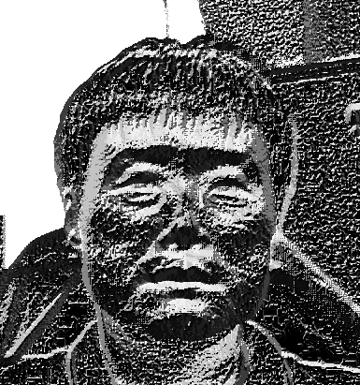
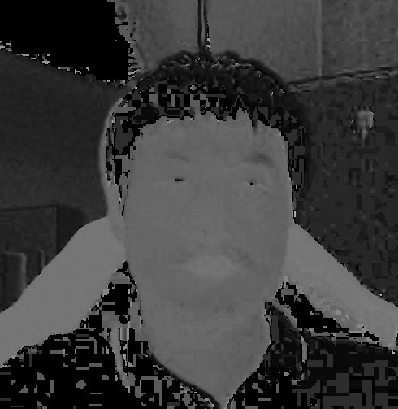
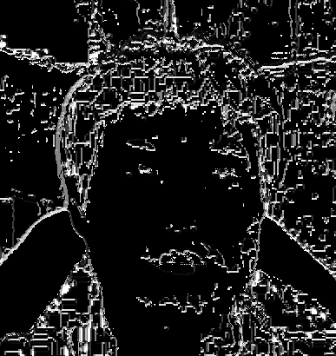

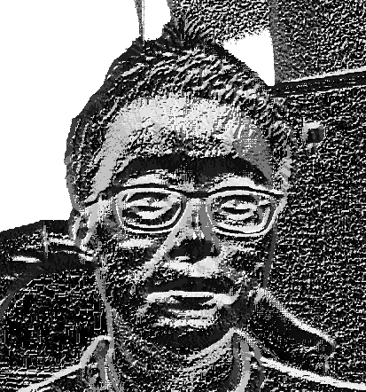


DISCUSSION
Hue-LBP does not capture detailed face patterns compare to the conventional LBP.
However, it generates patterns where hue-value changes (e.g. glasses).
* Note that each hue-image is quantized into 16 levels.
LBP
Hue-LBP

Slide 14
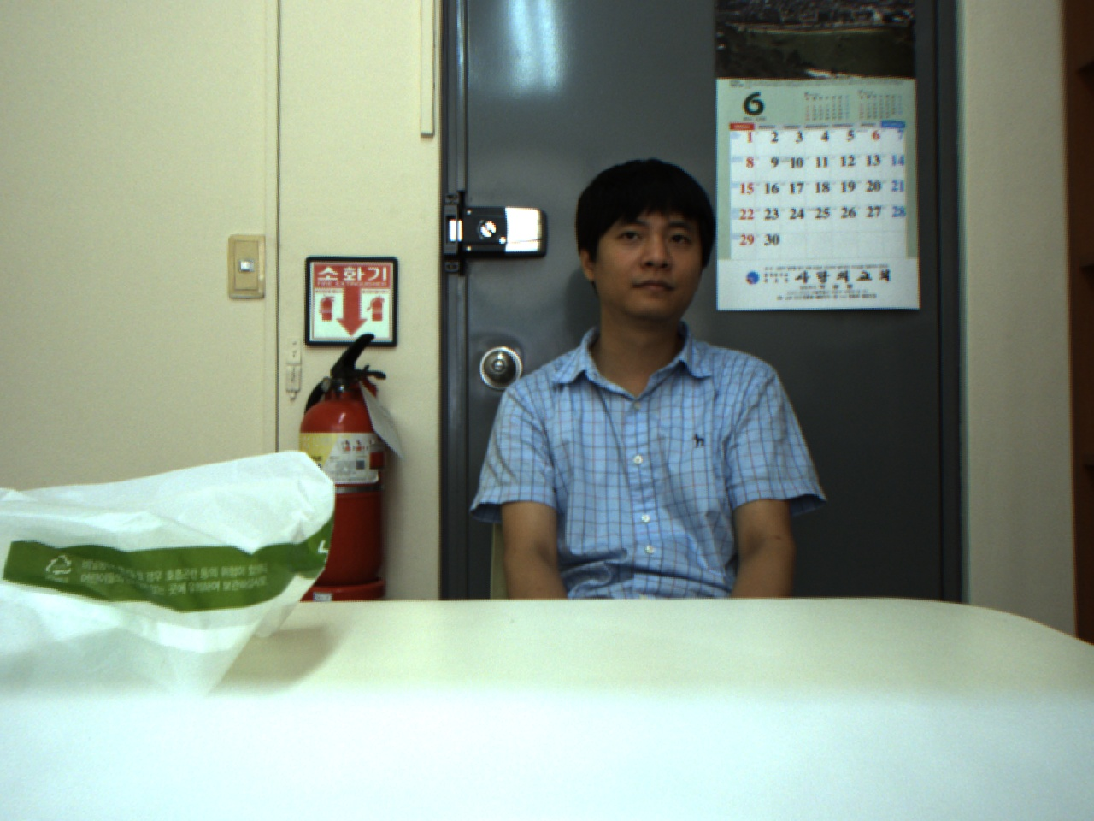
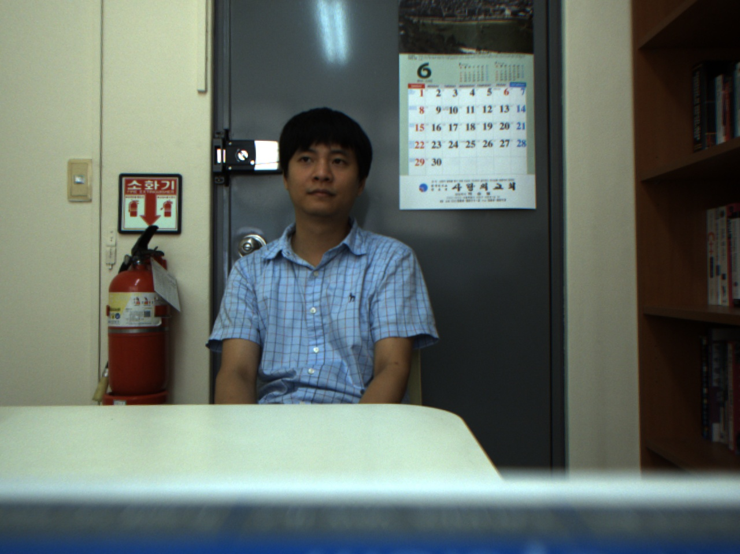
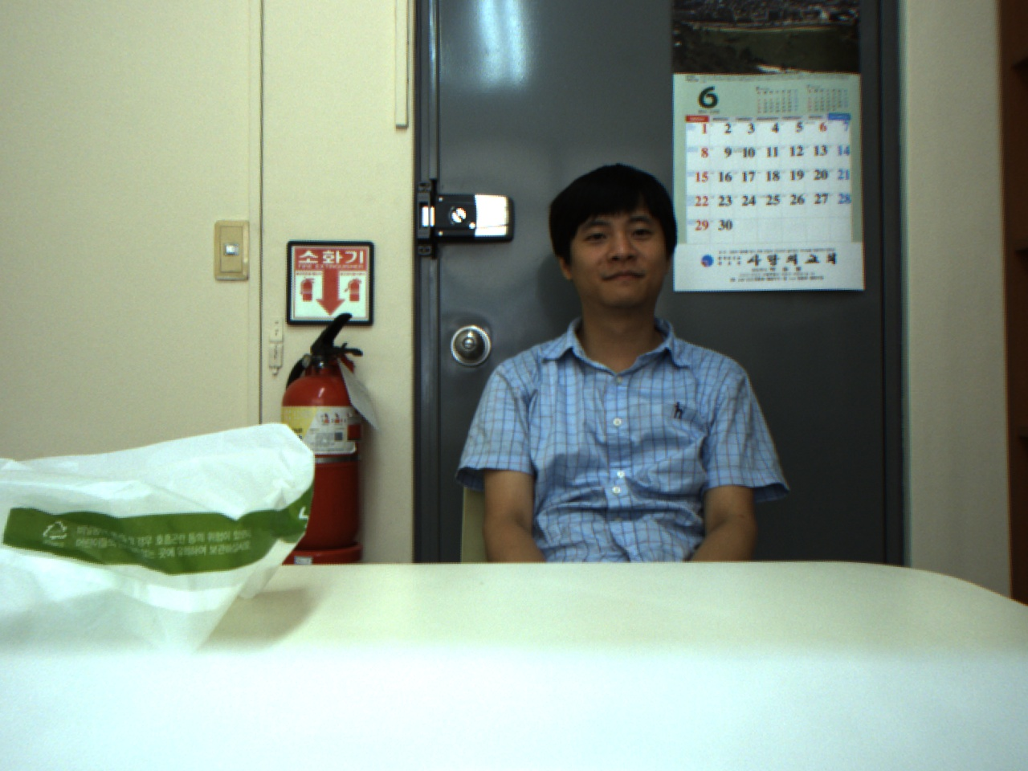
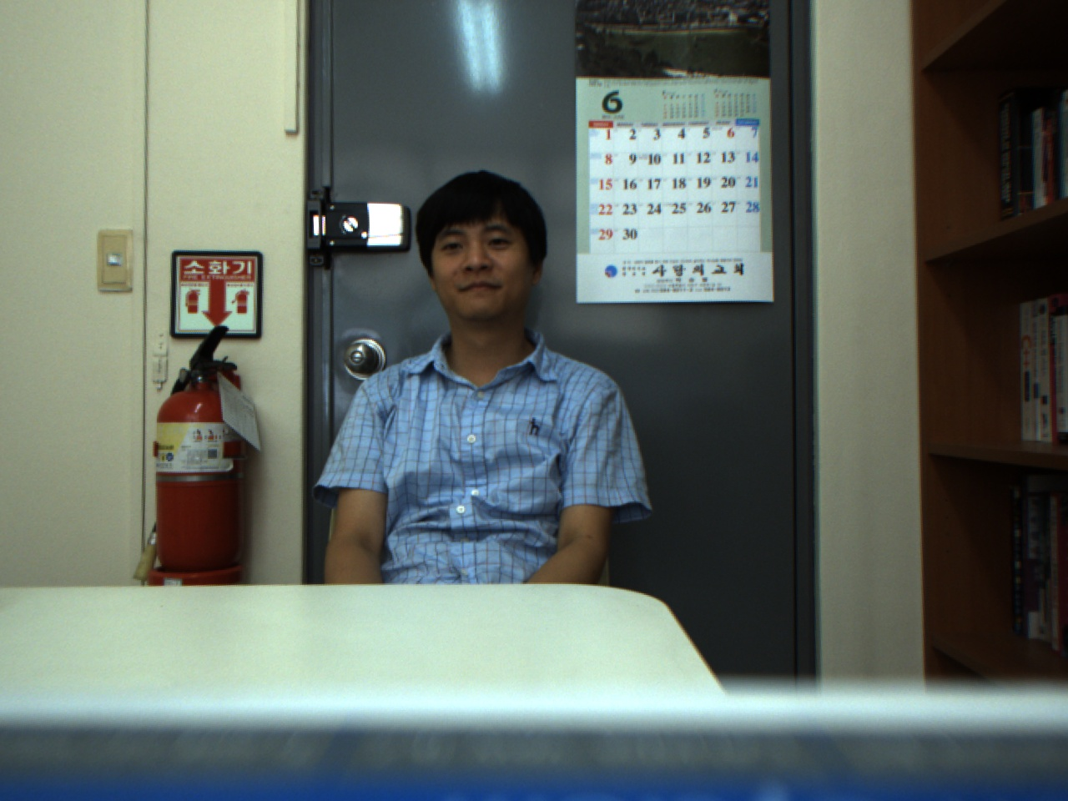
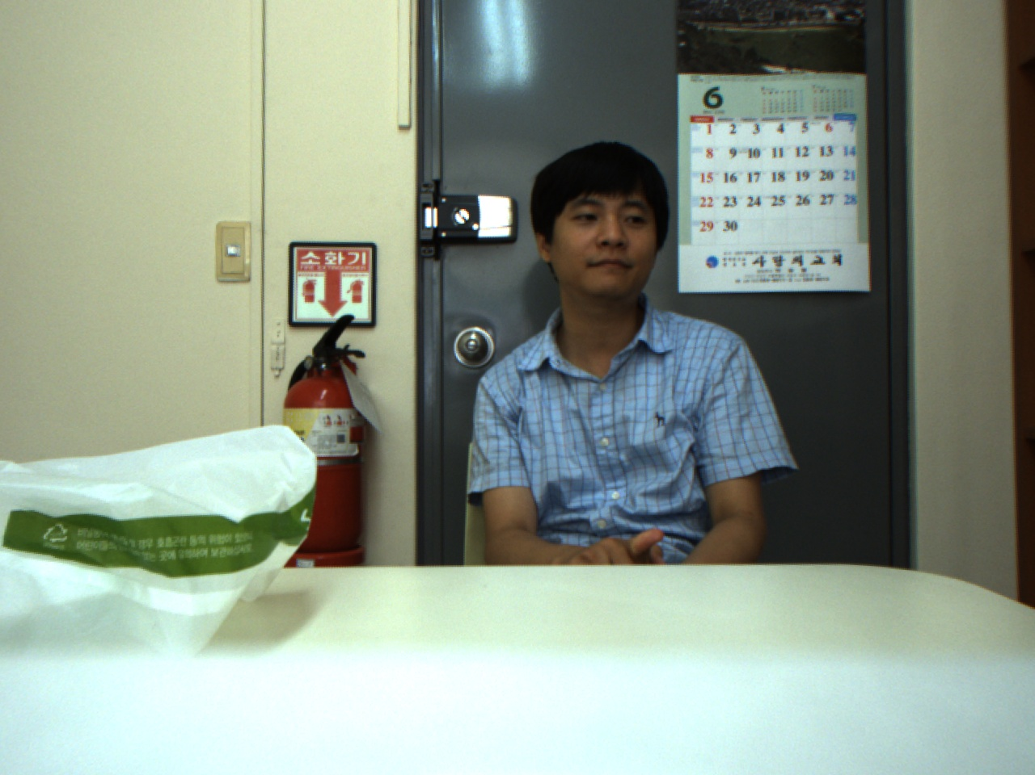
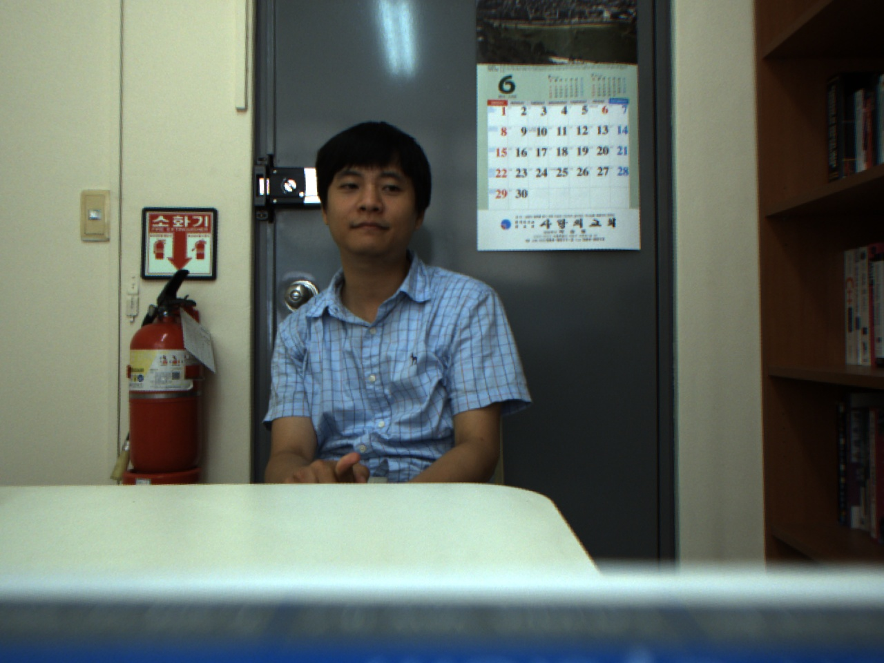
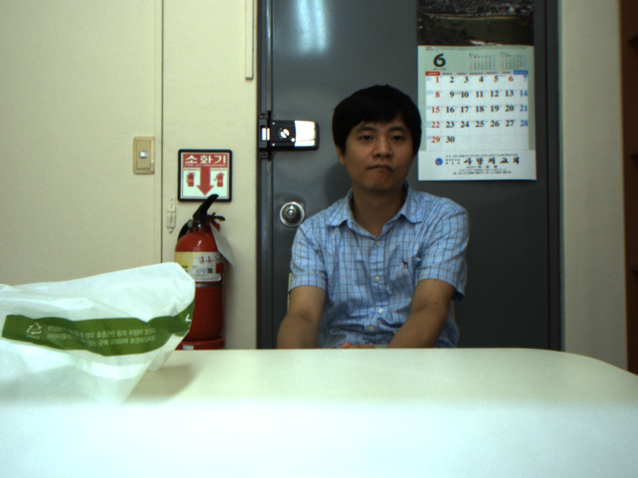

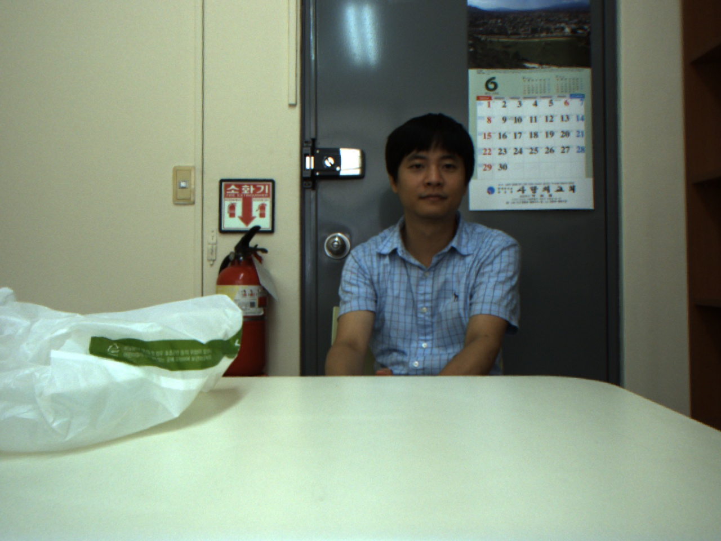

Discussion
Uniform LBP/Hue-LBP with P=8, R=2 - (HA 100%, SA 100%)
Good
Query

Slide 15
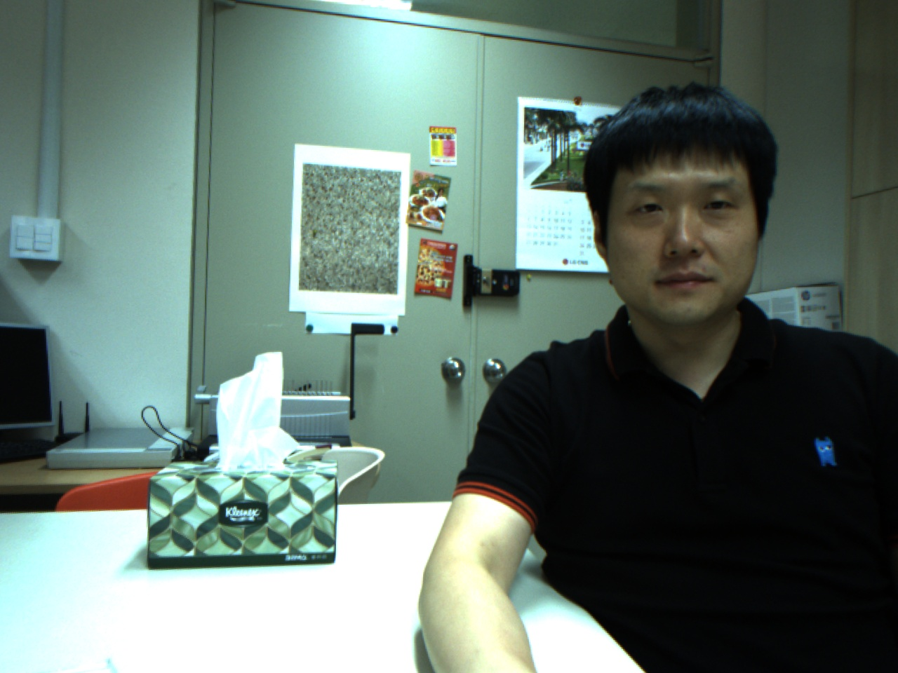
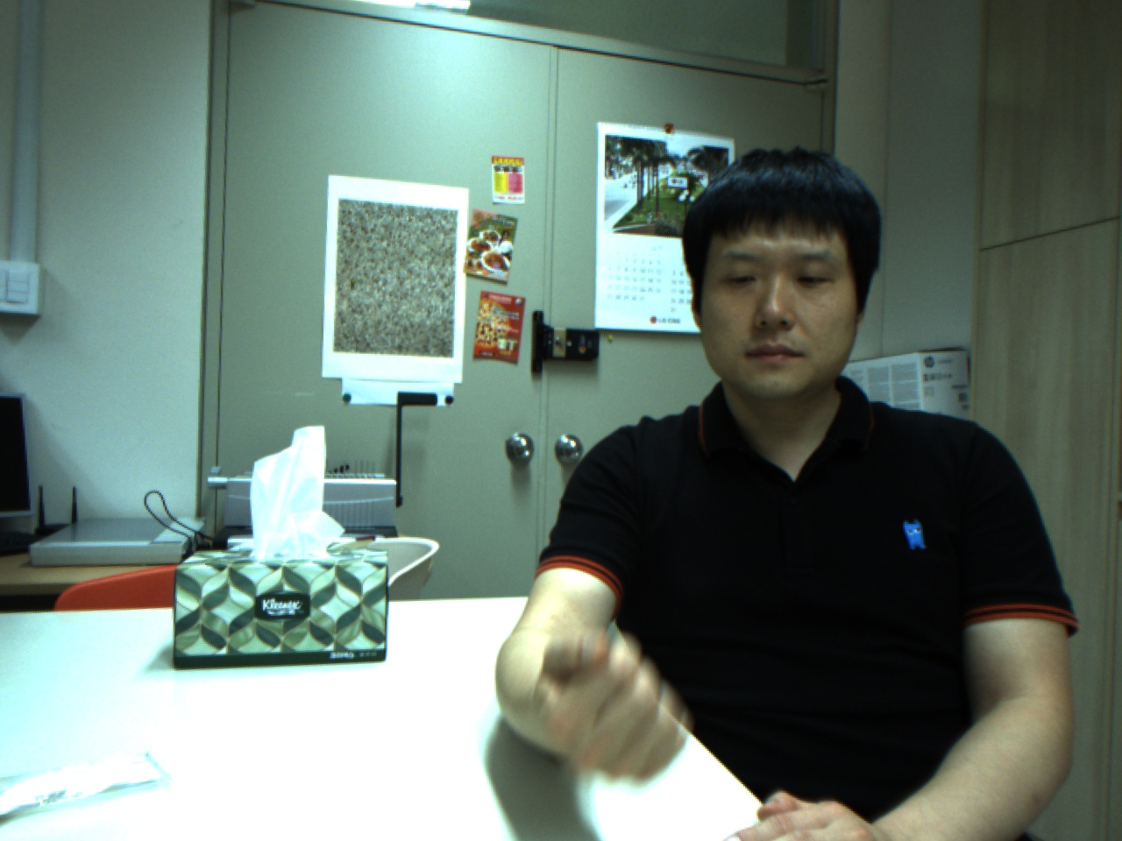
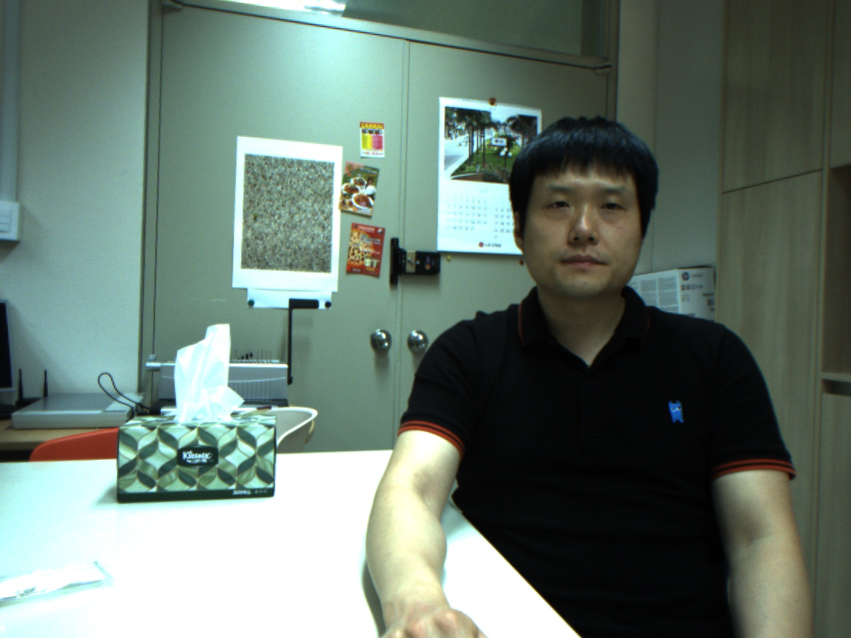
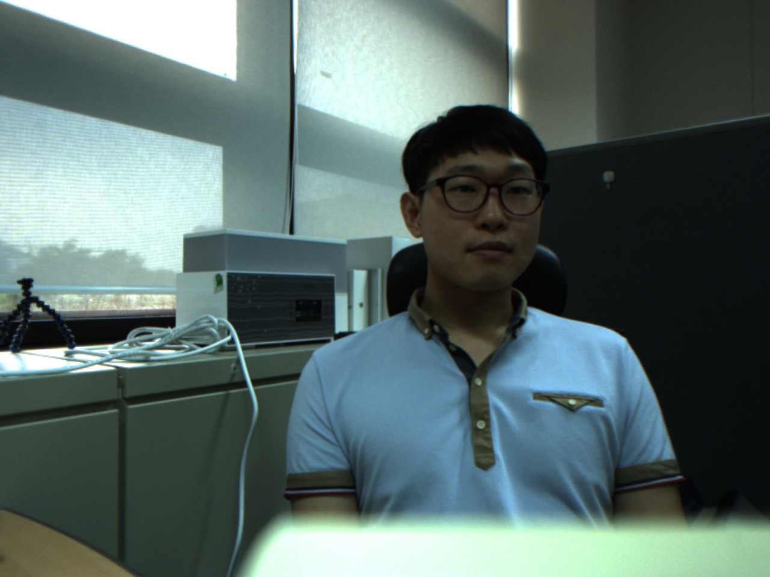
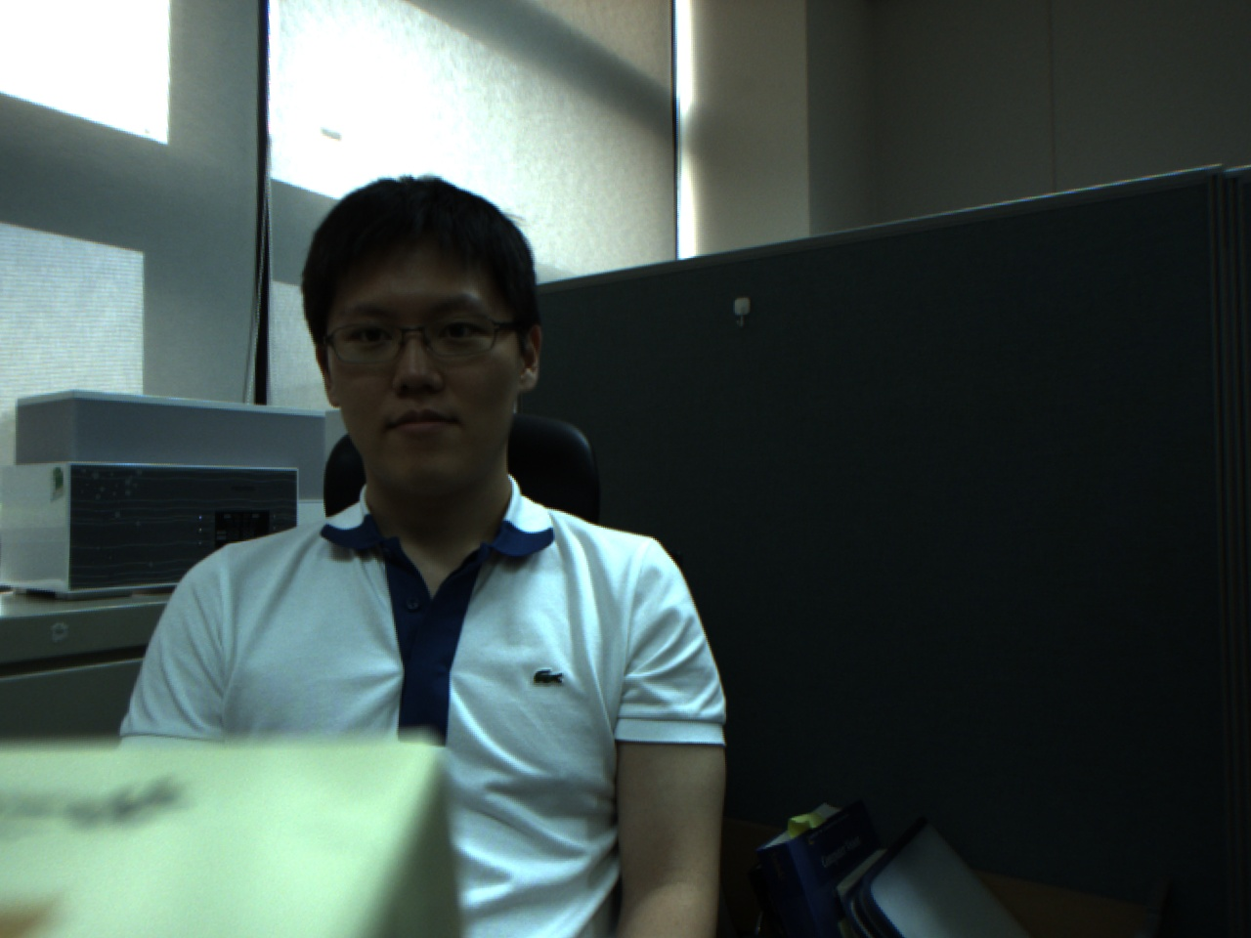
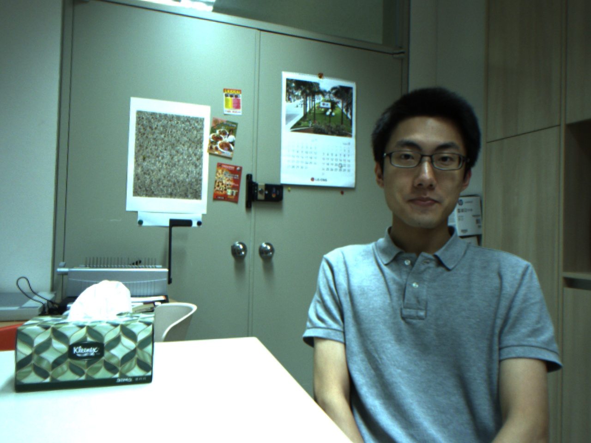
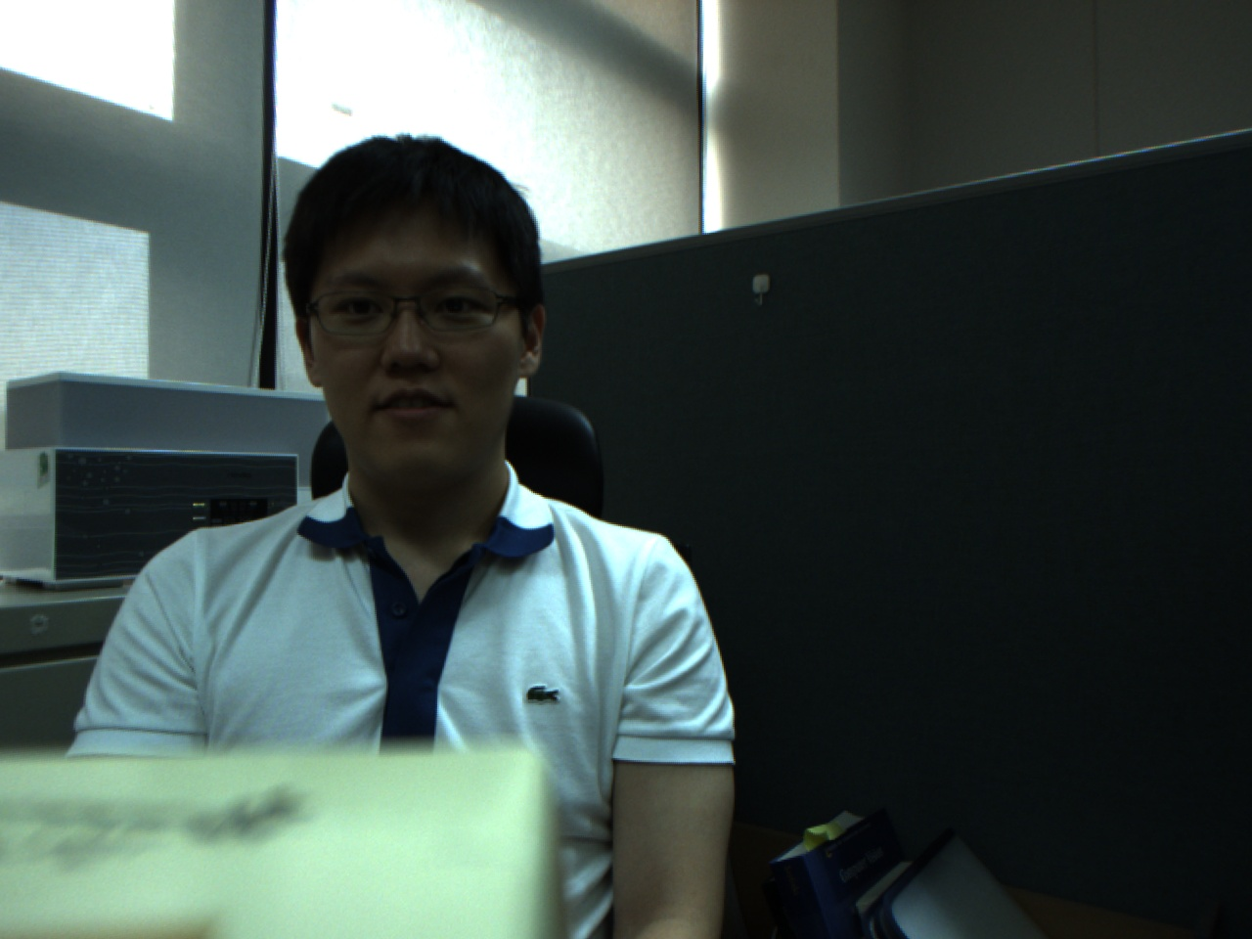
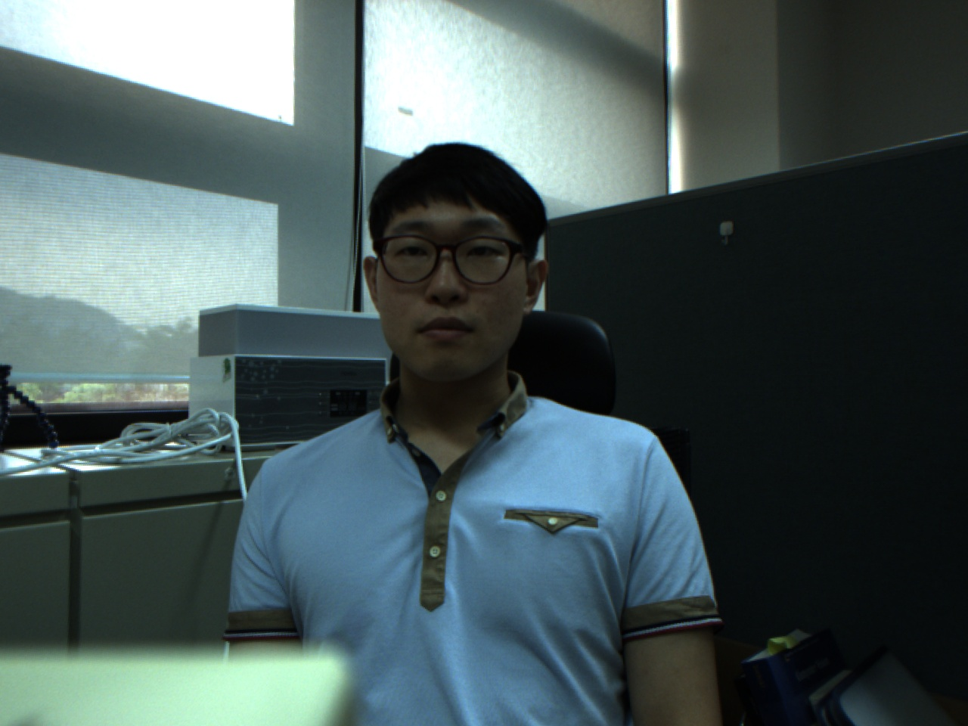
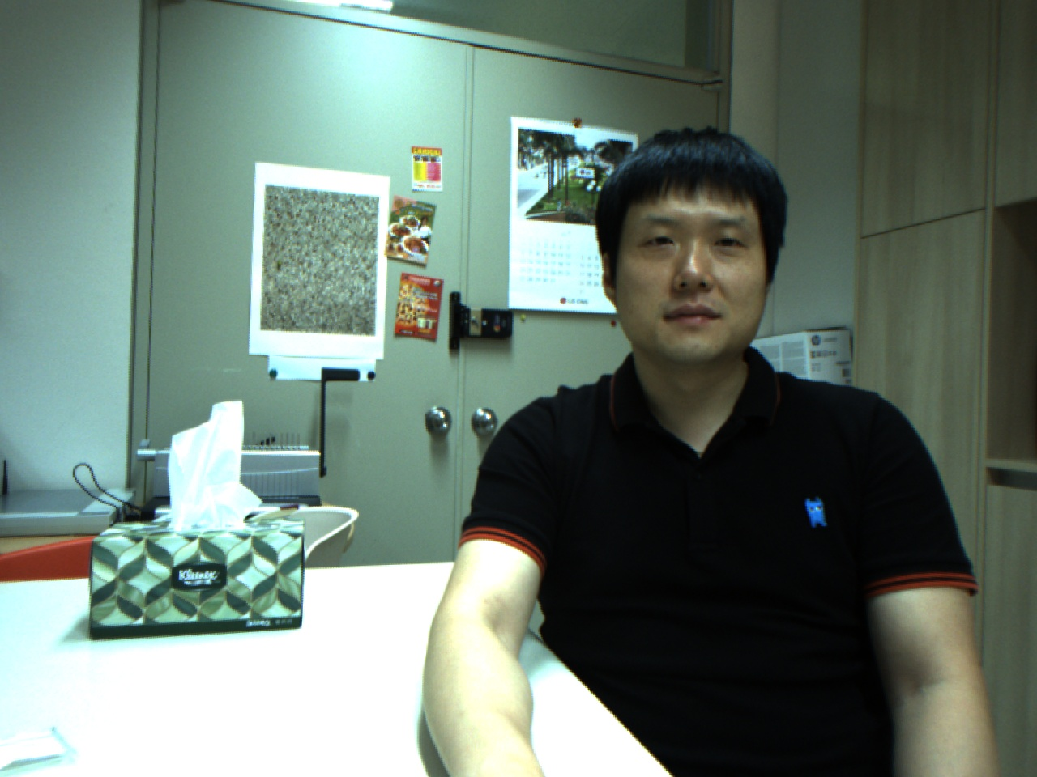
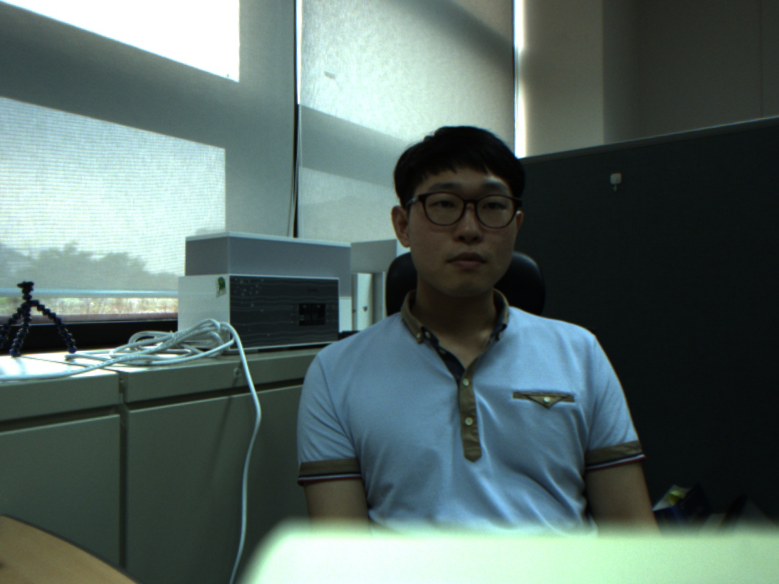
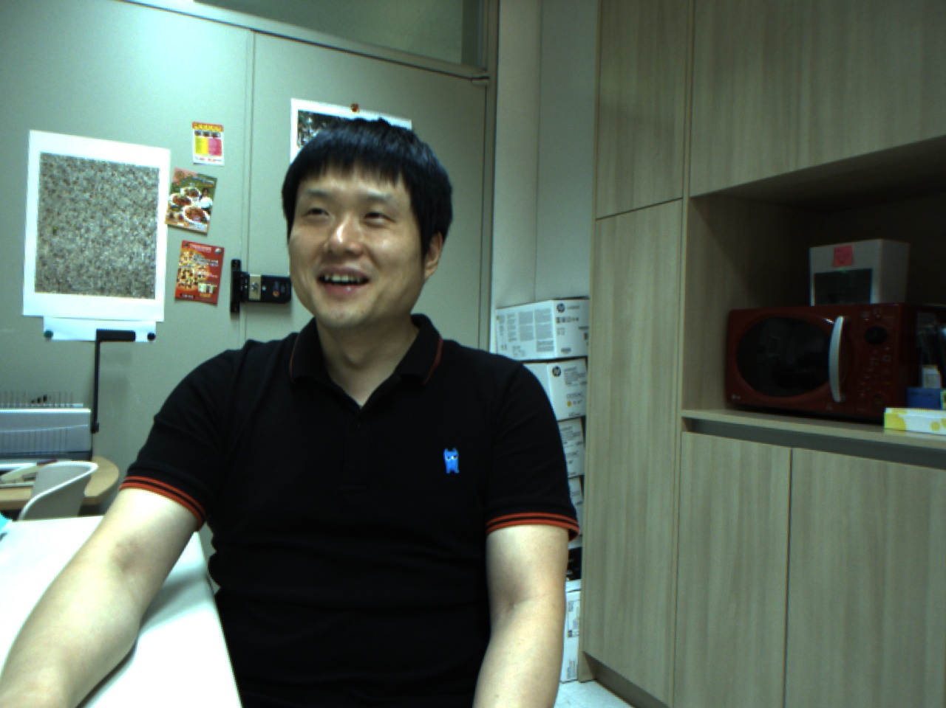
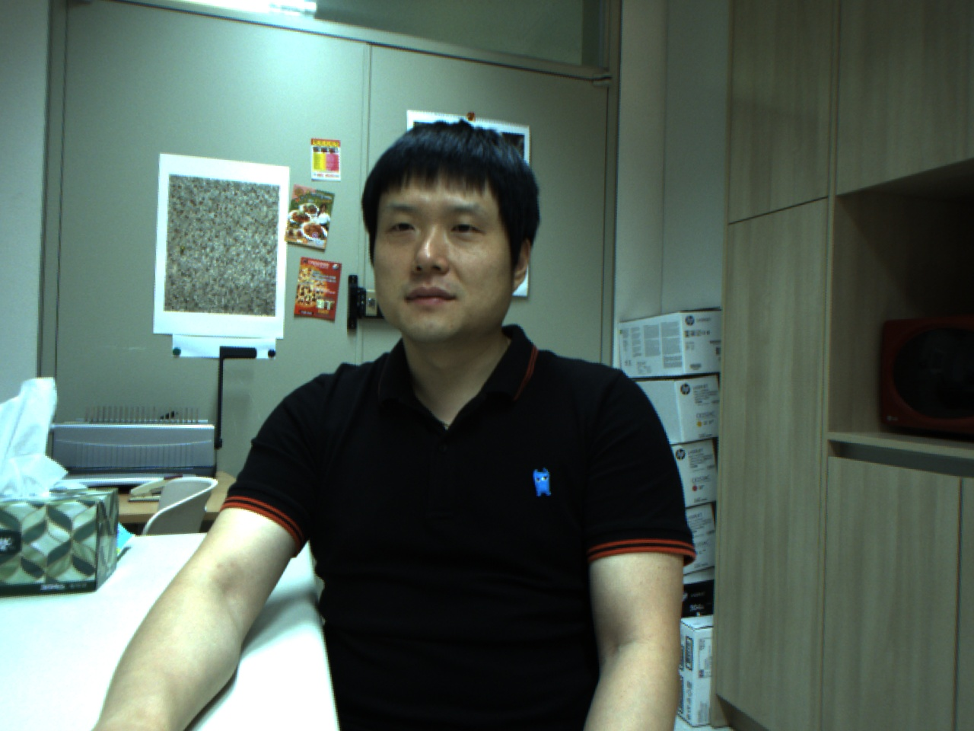


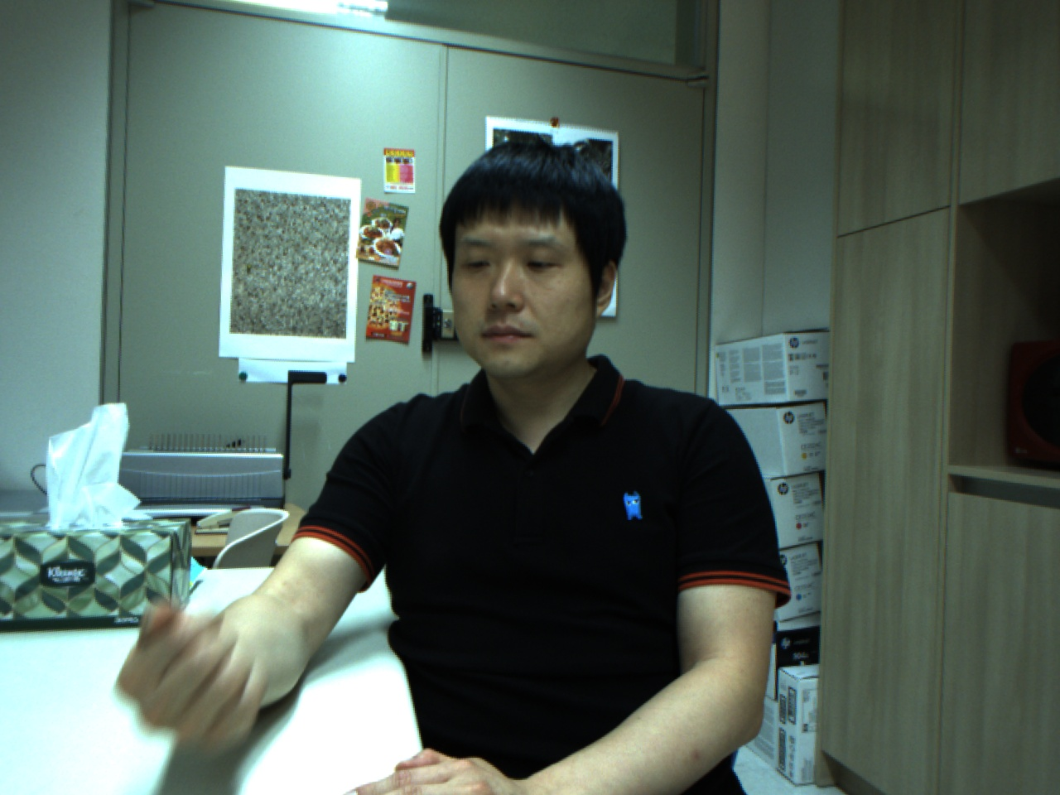

Discussion
Uniform LBP/Hue-LBP with P=8, R=2 - (HA 40%, SA 40%)
Bad
Query
Not-detected images: this image class has many variations such as head scale, tilt, expression compared to others.

Slide 16
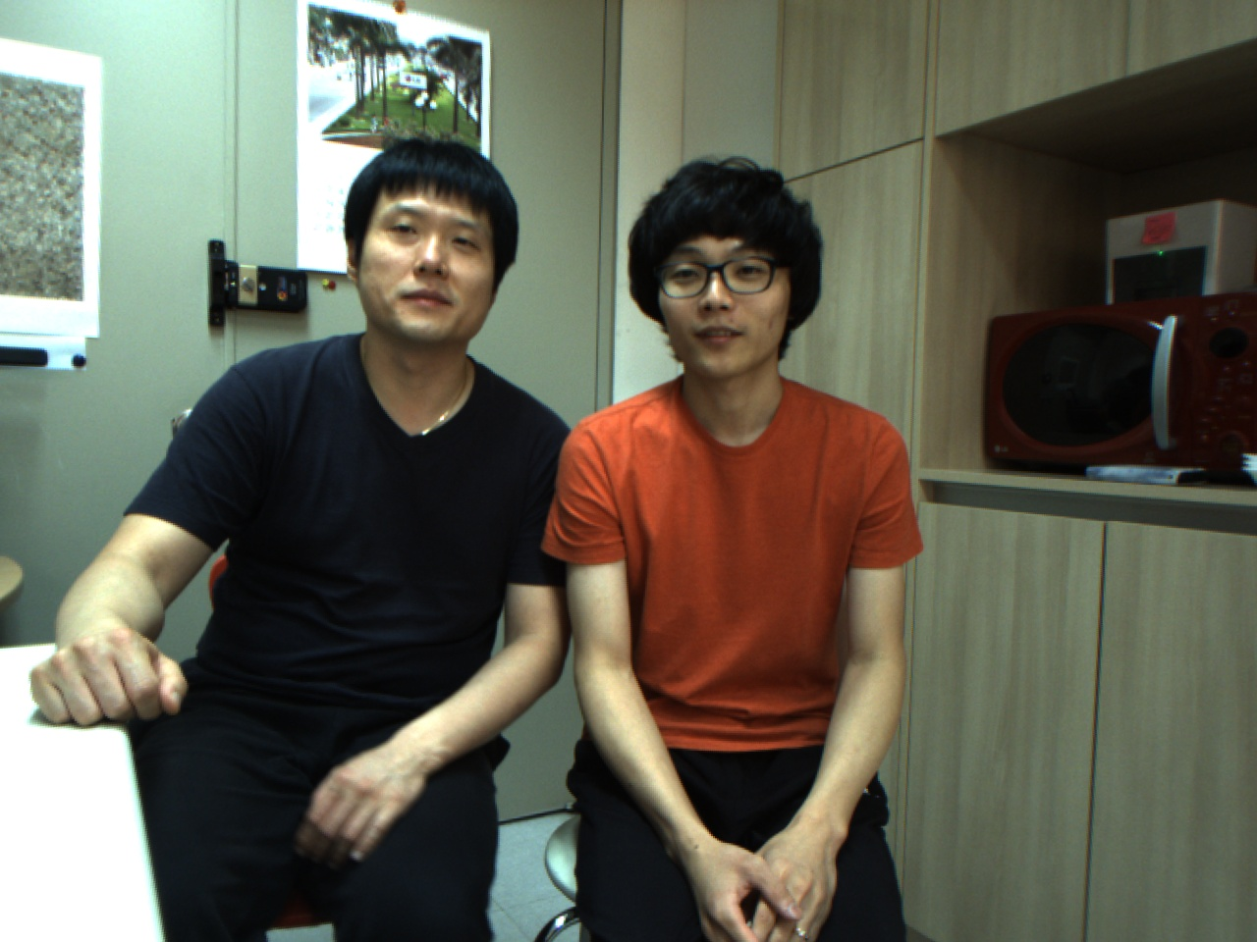
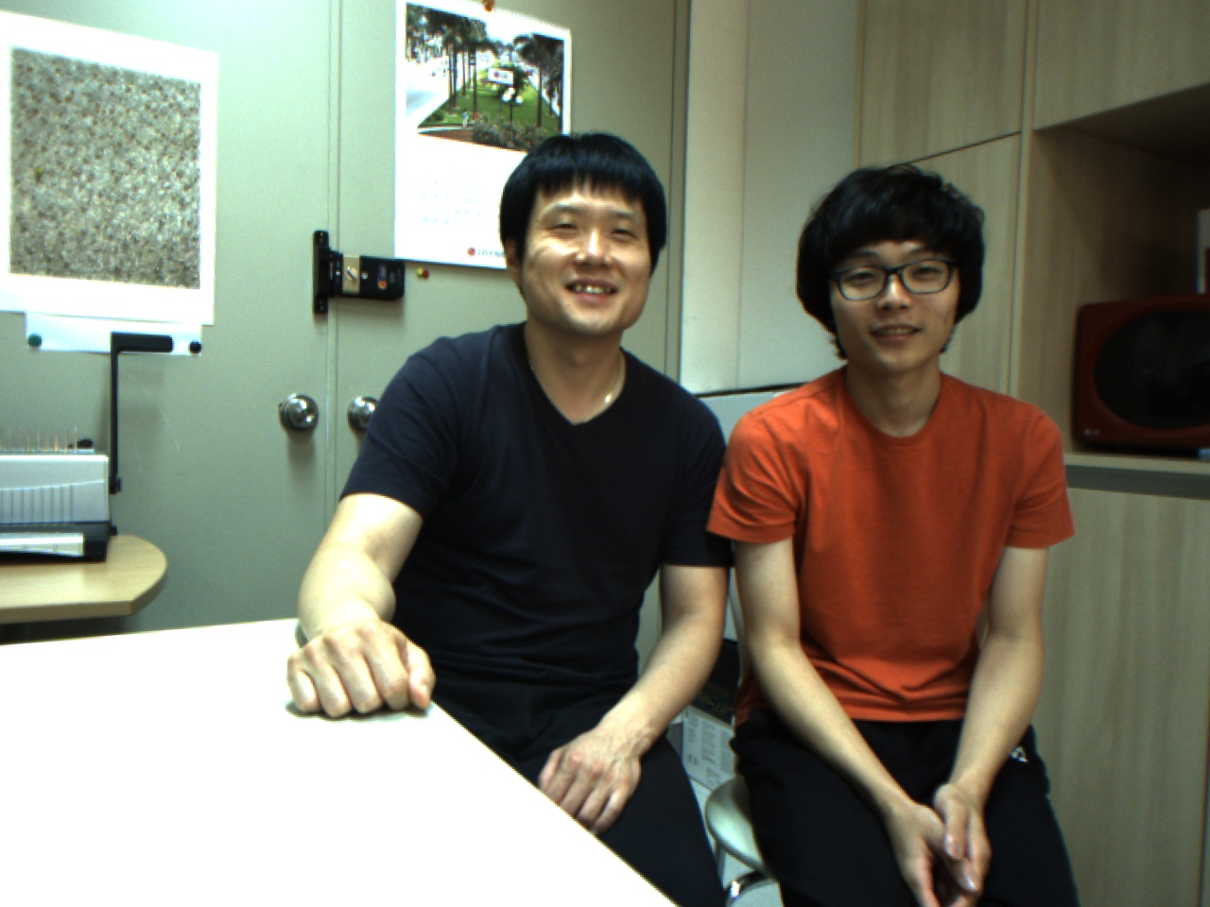
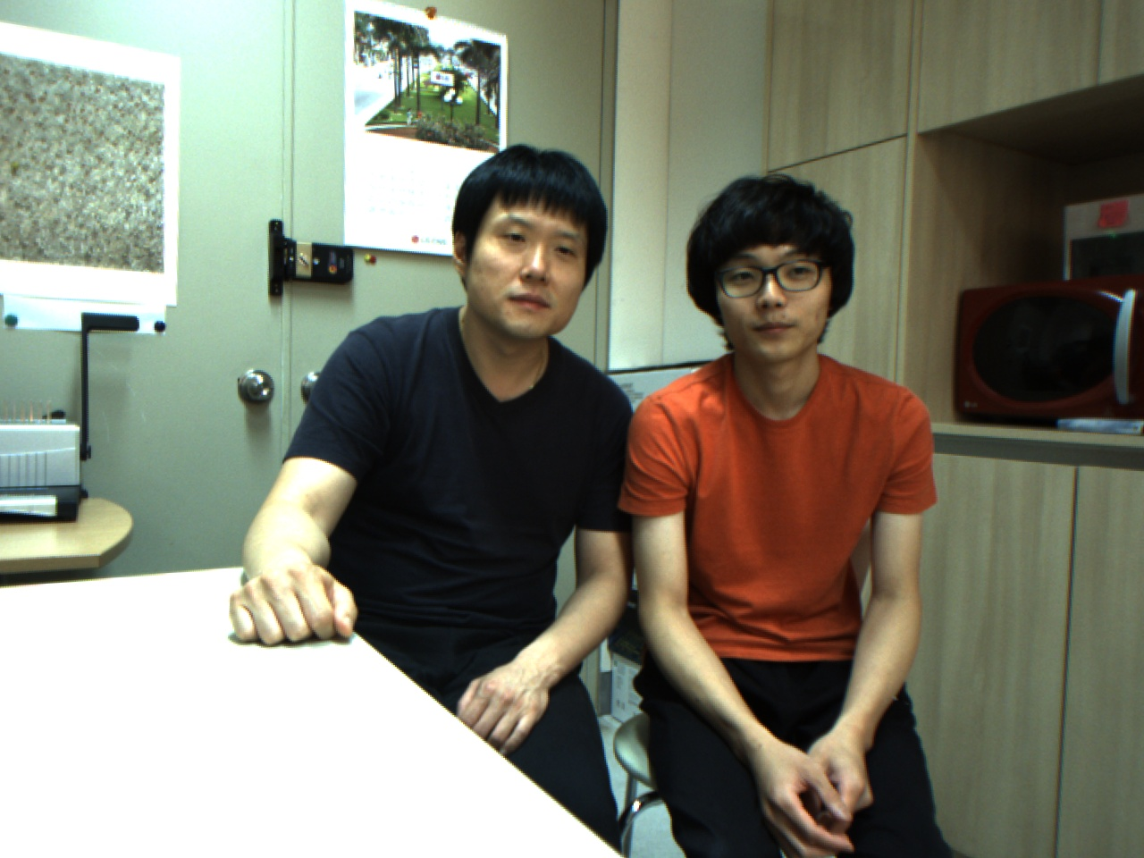
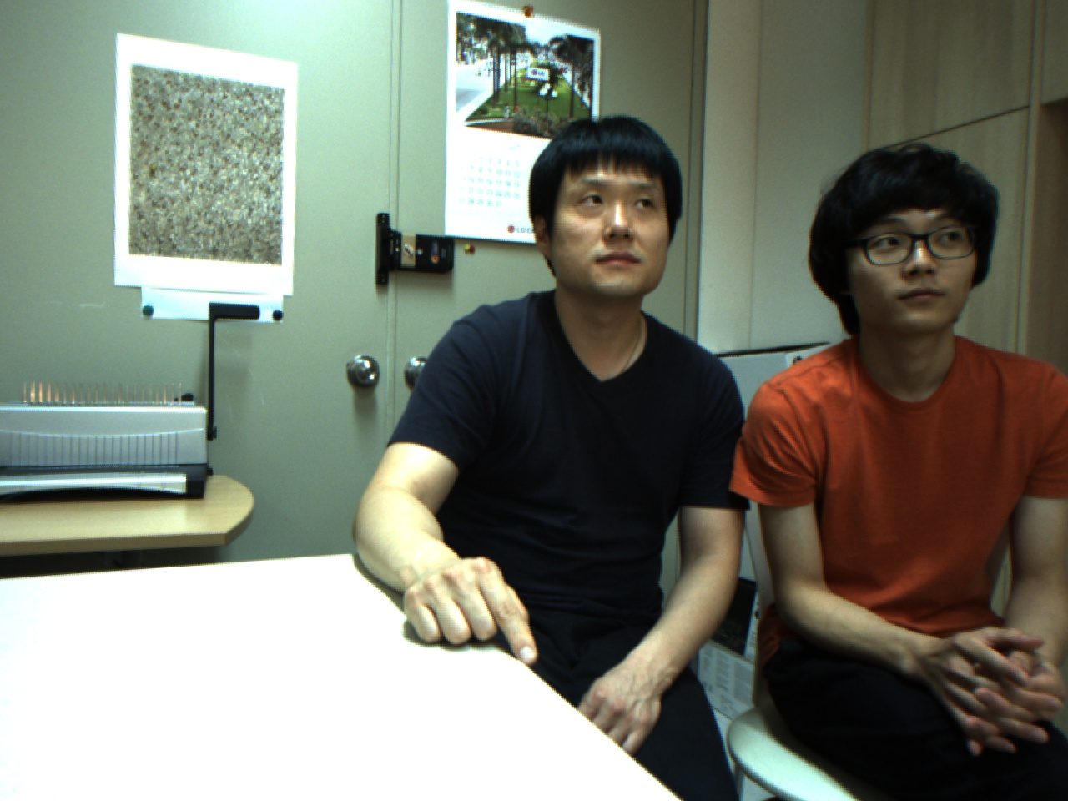
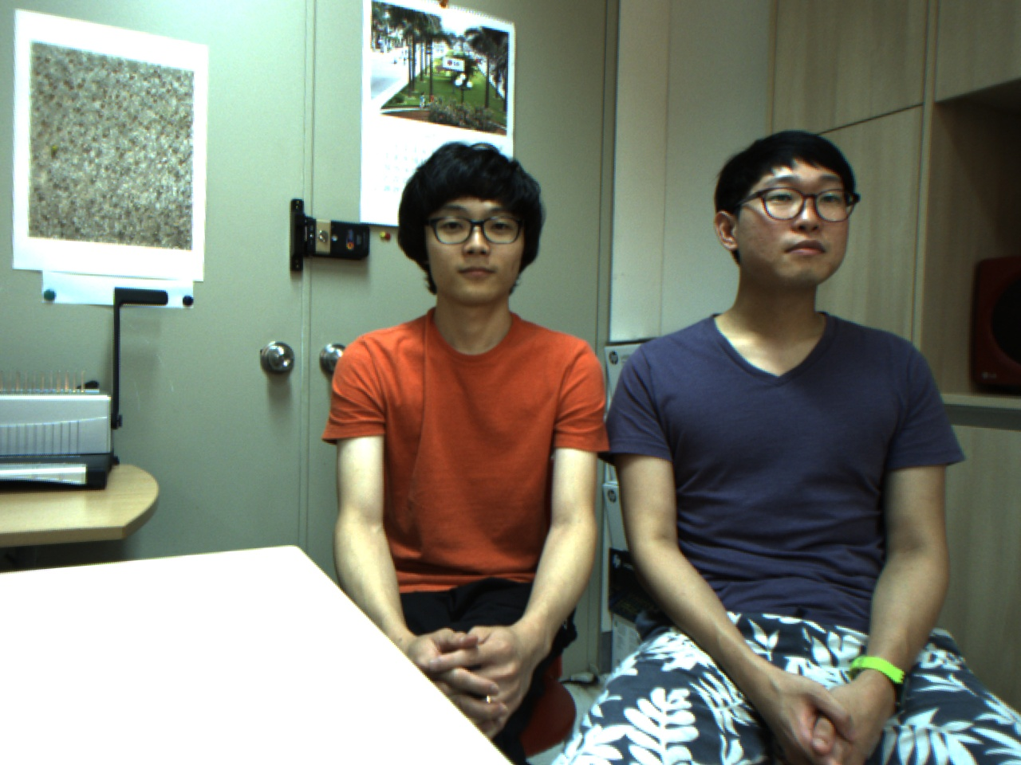
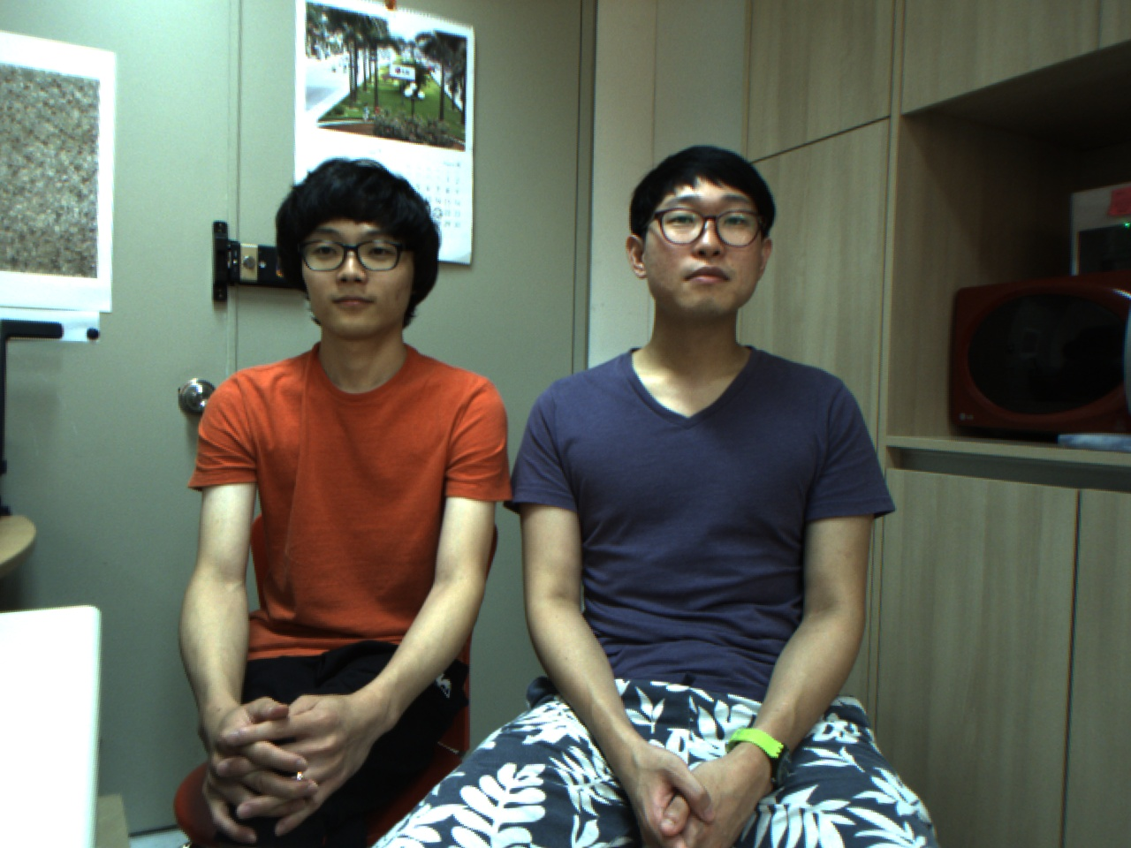
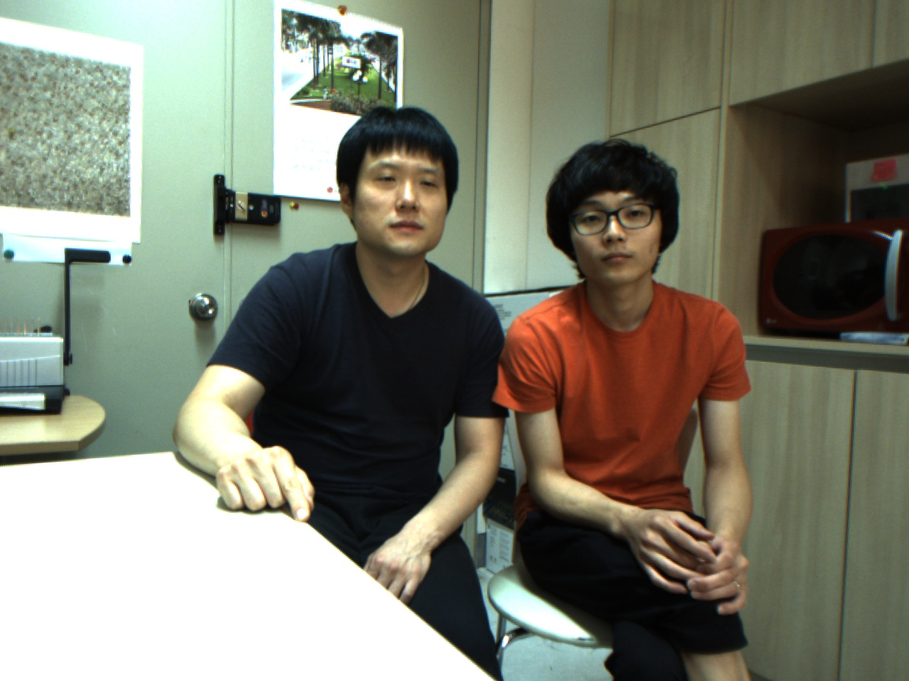
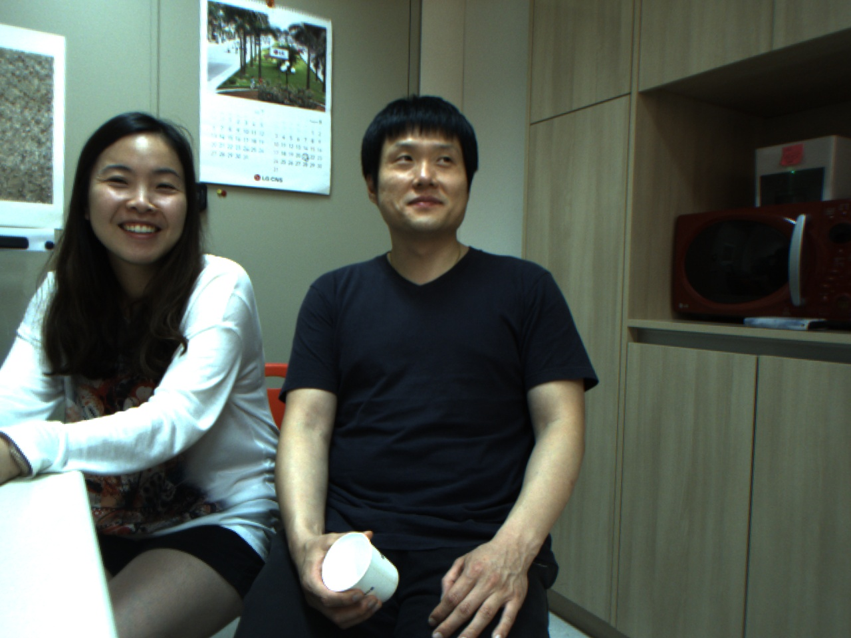











Discussion
Uniform LBP/Hue-LBP with P=8, R=2 – (HA 50%, SA 60%)
- The accuracy is low, but one of two people appears in images of different classes.

Slide 17



















DISCUSSION
GOOD : Uniform LBP/Hue-LBP with P=8, R=2 - (HA 100%, SA 100%)

Slide 18




















Discussion
BAD: Uniform LBP/Hue-LBP with P=8, R=2 - (HA 20%, SA 35%)

